Slide 1
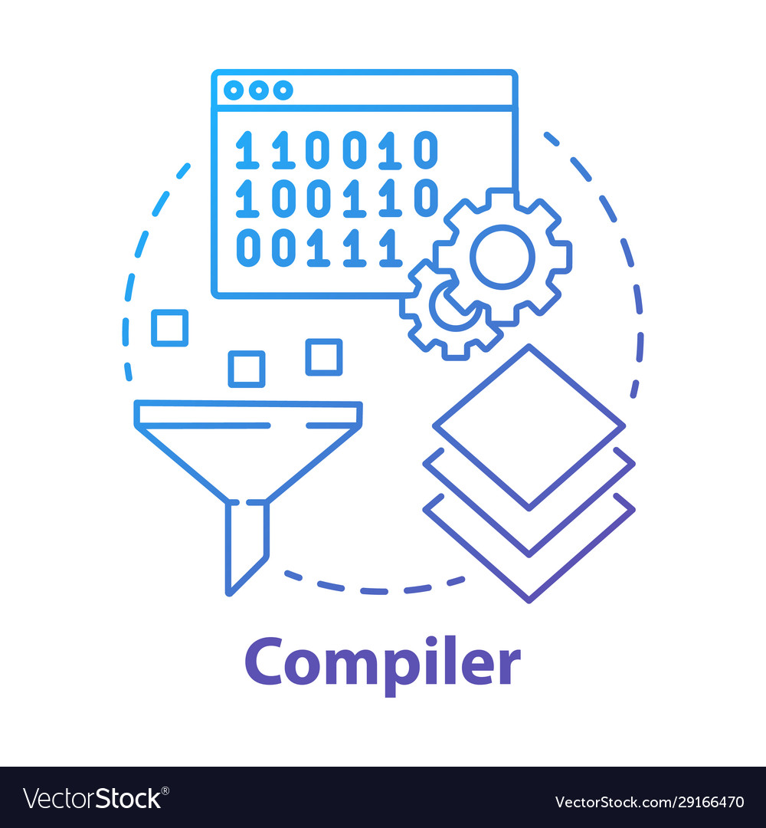
Epitome Language
WINONA FERNANDES (cs182032)
IQRA ANWAR (Cs182015)
AIMAN FATIMA (CS182011)

Slide 2
WHY EPITOME?
Epitome is a trendy-motive system and user-friendly programming language with a C++ like syntax that compiles to local code and is case sensitive. As the name suggests, it was designed and inspired by the team members of this group and hence has unique keywords to differentiate it from other languages. In Epitome language there will be some keywords, identifiers and operators that will help the user to solve algorithms in an easy way.
Epitome will prove as a hybrid that contains the functionality of the C++ programming language. This means that we will have all the features that are available in C++.

Slide 3
EPITOME LANGUAGE
Name of language: Epitome Language
Extension: .WAI
Epitome means a perfect example of anything.

Slide 4
C++ vs Epitome
C++ KEYWORDS | Epitome KEYWORDS
Int | iq
Float | wi
String | ai
Break | End
Continue | Location

Slide 5
KEYWORDS: IF, ELSE, LOCATION (CONTINUE), END (BREAK),
DISPLAY (PRINT), READ (INPUT), WHILELOOP
OPERATORS: +, -, *, ++, - -, %, &&, |, <+, >=, !=, ==, <, >, =
SPECIAL CHARACTERS: #, @, $, %, ^, &, |, (, )
DELIMITERS: , ; { } . _
SINGLE LINE COMMENT: //””

Slide 6

IDENTIFIERS:
A collection of A-Z, a-z and 0-9.
KEYWORDS:
Specific set of keywords are defined in the grammar. These cannot be used as identifiers.
PRE PROCESSOR DIRECTIVES:
Pre processors must start with a # and followed by a keyword.

Slide 7
BISON PARSER
FLEX SCANNER
Flex is a computer program that generates lexical analyzer (fast)
Lexical Analyzer is a scanner that converts HLL to stream of tokens to be mapped.
Tokens are sequence of characters.
Functioning of Lexical Analyzer Tokenization , removal of white spaces, removal of comments.

Slide 8
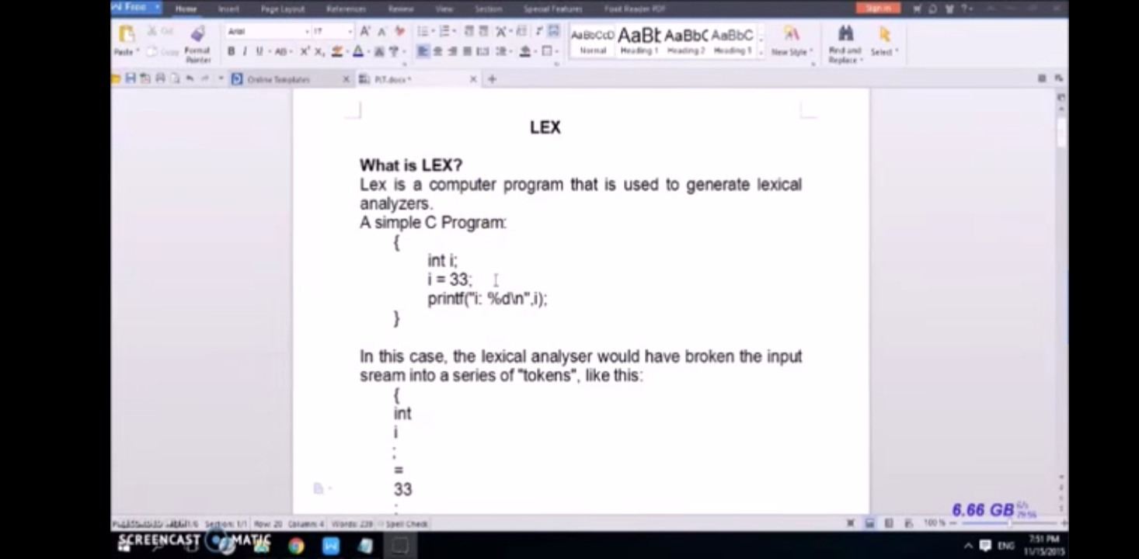
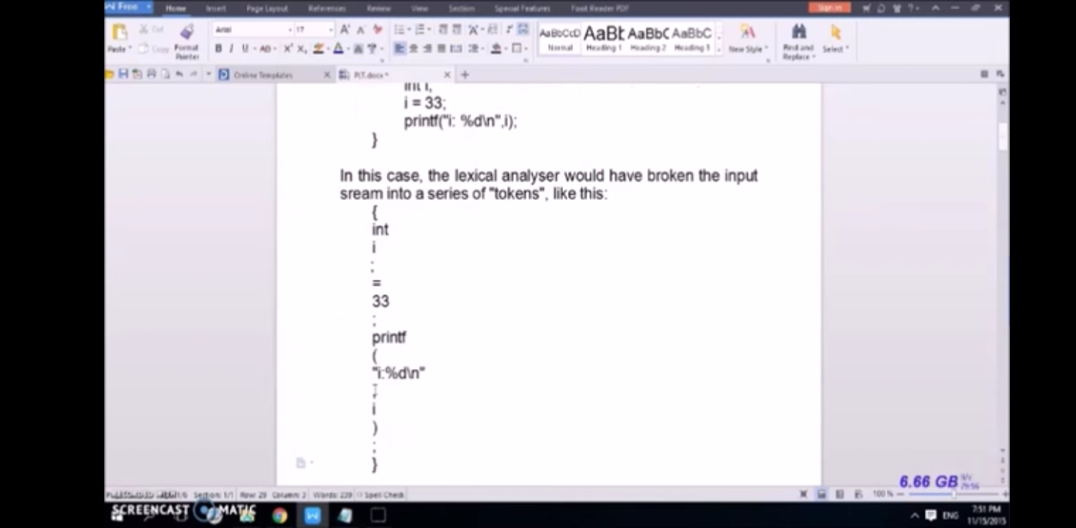

Slide 9
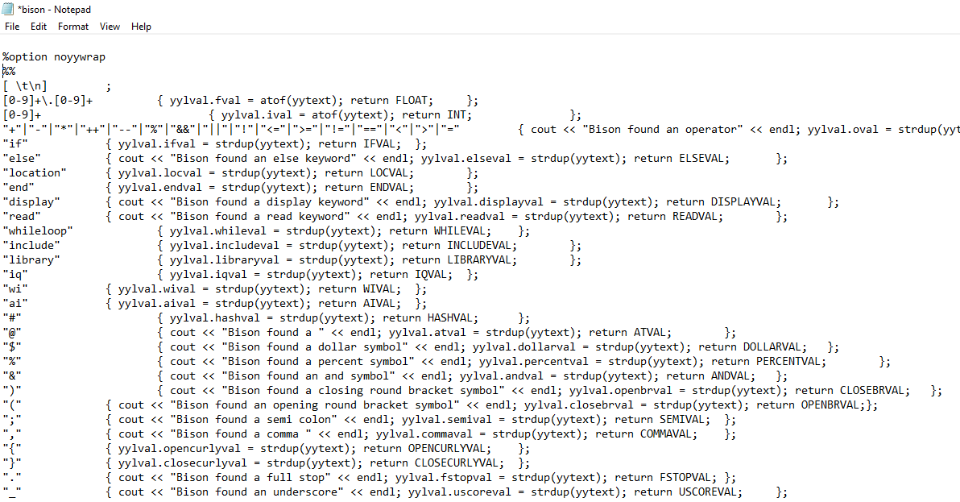
FLEX-BISON CODE

Slide 10
BISON PARSER
Epitome’s Bison parser recognizes data types like int, float, and string. It also recognizes keywords, delimiters, special characters, operators, conditional statements, pre processor directive, single line comments and a while loop.

Slide 11
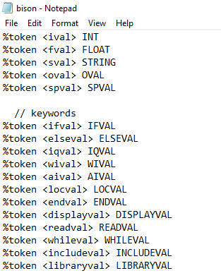
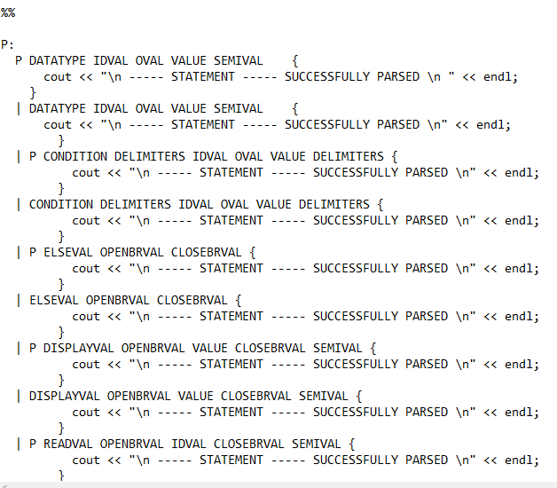
FLEX-BISON CODE

Slide 12
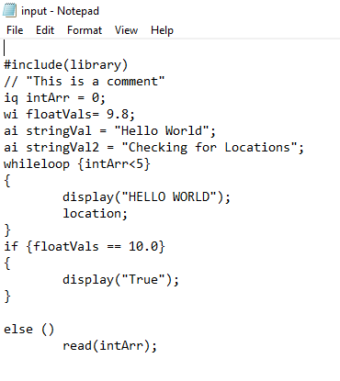
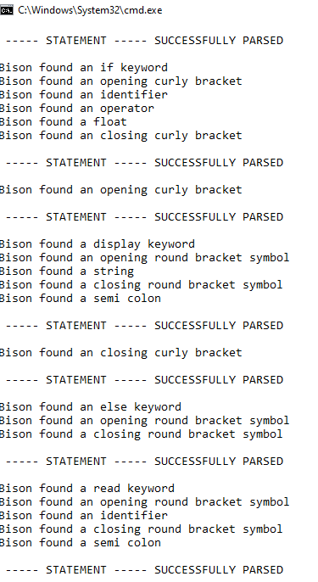
FLEX-BISON OUTPUT

Slide 13
BISON PARSER
LEXICAL ANALYZER
Lexical analysis is the process of taking an input string of characters (such as the source code of a computer program) and producing a sequence of symbols called lexical tokens, or just tokens, which may be handled more easily by a parser.

Slide 14
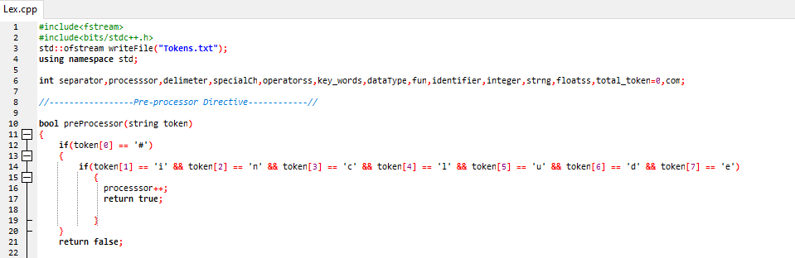
LEX.CPP

Slide 15
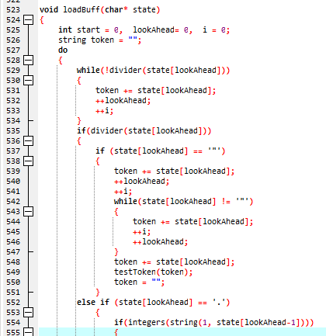
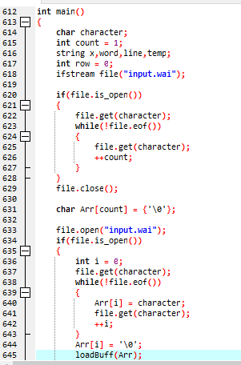
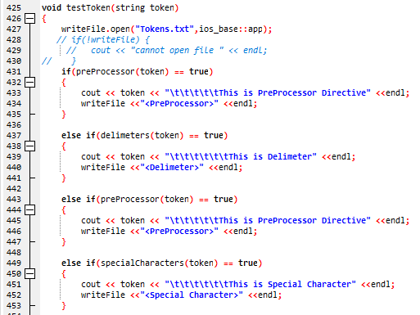
LEX.CPP

Slide 16
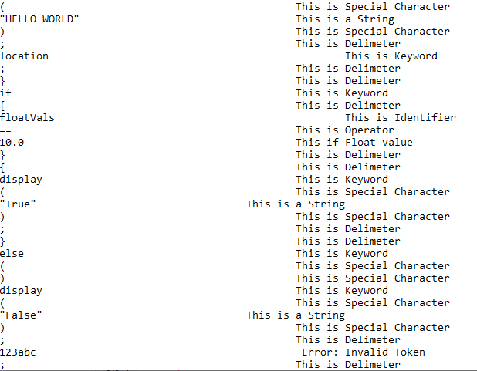
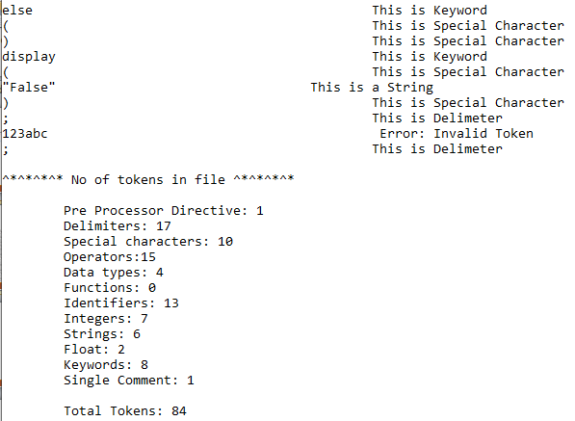
OUTPUT

Slide 17
BISON PARSER
RECURSIVE DESCENT PARSER
A recursive descent parser is a top-down parser that’s built from a set of mutually recursive procedures. Each procedure implements one of the non terminals of the grammar. Hence, the structure closely resembles the grammar it recognizes.
The grammar is given to the Recursive descent parser that maps it accordingly and produces a success or failure in parsing. If the rules of grammar are not followed, we will be prompted with an error. For eg: In this particular grammar, a data type must be followed by an identifier. $ signifies the end of program.

Slide 18
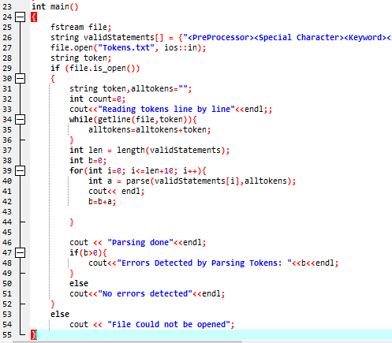
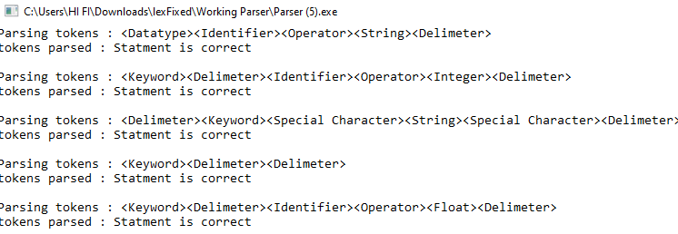
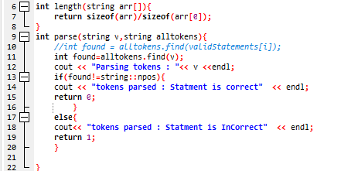
input
output

Slide 19
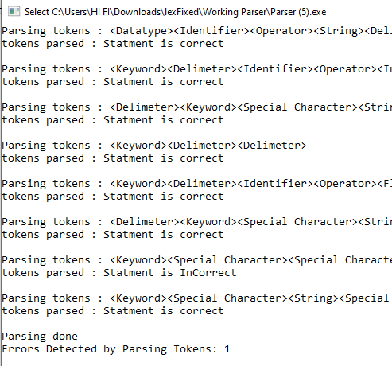
ERROR CODE

Slide 20
CONTRIBUTIONS
Language Specification Document (Winona)
NFA TO DFA (paper work) (Aiman & Iqra)
Lexical Analyzer (DFA) (Aiman, Iqra & Winona)
Flex Scanner (Iqra)
Bison Parser (Winona)
Recursive Descent Parser (Aiman & Iqra)
Presentation (Aiman & Winona)

Slide 21
THANK YOU!

